Slide 1

Building & Mining Knowledge Graphs
(KEN4256)
Lecture 4: Property Graphs
Kody Moodley

Slide 2
Outline
Recap & Summary of Semantic (RDF) Knowledge Graphs
Introduction to Property Graphs
What are they?
Property graph implementations
Comparison between RDF KGs and Property Graphs
Differences in representation
Differences in querying: Cypher examples (vs SPARQL)
Strengths & drawbacks
Summary

Slide 3
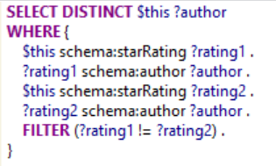

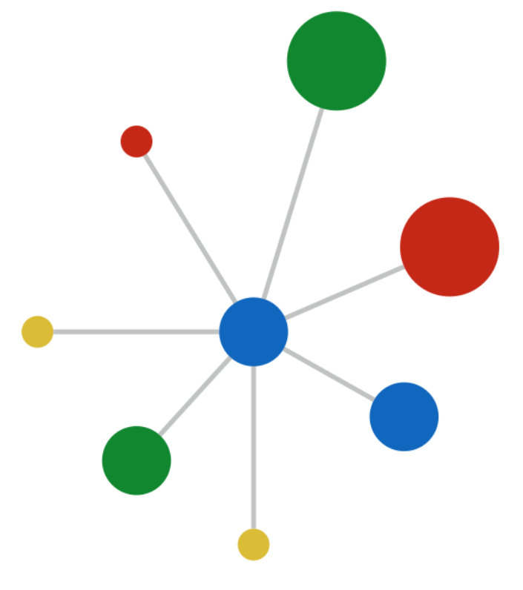
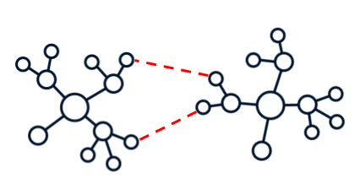

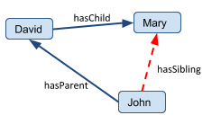

Recap & summary of RDF KGs
Lecture 1, labs 1 & 2:
Definition and application of semantic (RDF) KGs
<subject> <predicate> <object>
Wikidata & DBpedia
Lab 3:
Converting data sources to RDF (Using RML)
SPARQL (querying RDF KGs)
Lecture 2 & lab 4:
FAIR, metadata, provenance
Assessing FAIRness of KGs
rml:logicalSource [ rml:source "worldbank.xml" ; ... ];
Lab 5:
Linking RDF data with LIMES (using “owl:sameAs”)
Lecture 3 & Lab 6:
Types of KG quality issues
Validating KG quality with ShEx constraints
Lecture 4 & lab 7:
KG completion
Can we automatically enrich information in KGs?
:User { schema:name xsd:string ; schema:birthDate xsd:date? ; schema:gender [schema:Male
schema:Female ]

Slide 4
Property Graphs

Slide 5
What is a (Labeled) Property Graph?
...model in which vertices and edges in the graph can be associated with arbitrary properties as key-value pairs…
van Rest et al. (2016), PGQL: a Property Graph Query Language
... a directed labeled graph like RDF, but with attributes that can be associated with each vertex or edge Sun et al. (2015). Sqlgraph: An efficient relational-based property graph store

Slide 6
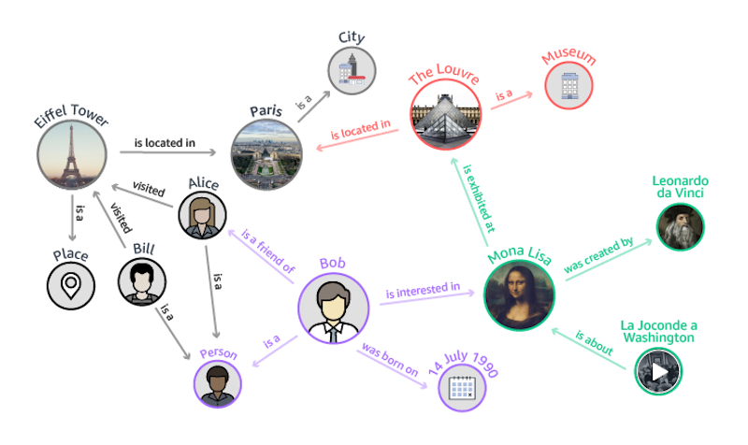
What is a (Labeled) Property Graph?

Slide 7
What is a (Labeled) Property Graph?
RDF
<http://.../bob> <http://…/birthdate> “1990/07/14”^^xsd:date .

Slide 8
What is a (Labeled) Property Graph?
Born : 1990/07/14
Height : 1.83m
...
LPGs

Slide 9
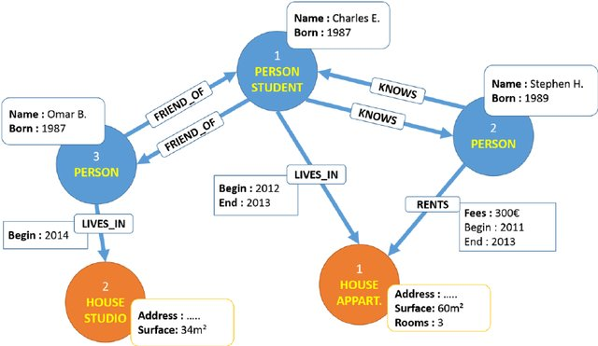
What is a (Labeled) Property Graph?
Key-value properties can be assigned to both nodes & edges
Graph G = (V, E)
Directed
Each v∈V and e∈E can have properties associated with them (in the form of key-value pairs)
Each node & edge has an ID, type, attributes
Type = Label
Image by: Raouf Bouhali, Laboratoire d'Informatique de Robotique et de Microélectronique de Montpellier. 2015

Slide 10
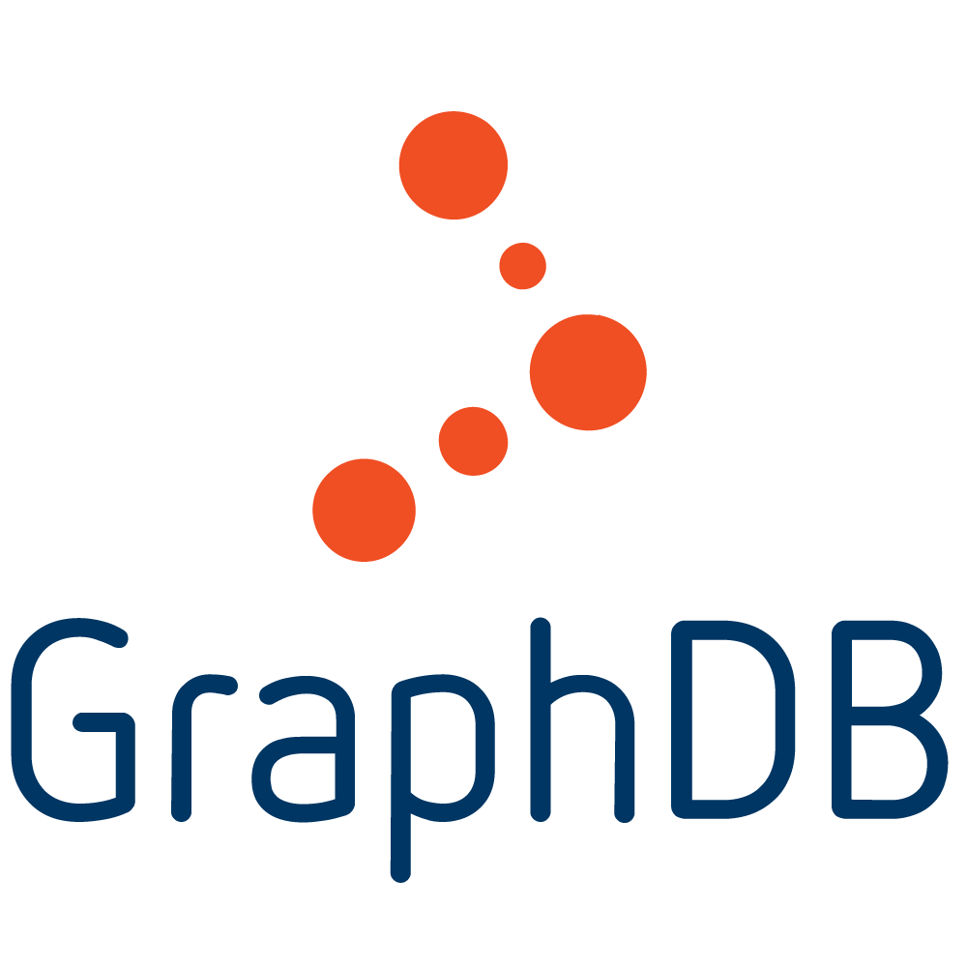



Semantic graphs
RDF store implementations
Formalism
Query language

Slide 11
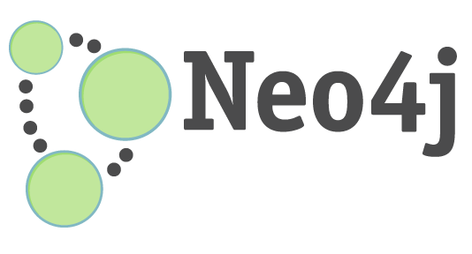


Property graphs
Implementations
Formalism
Query languages
?
Cypher
Gremlin
PGQL
A.k.a “Graph databases”

Slide 12
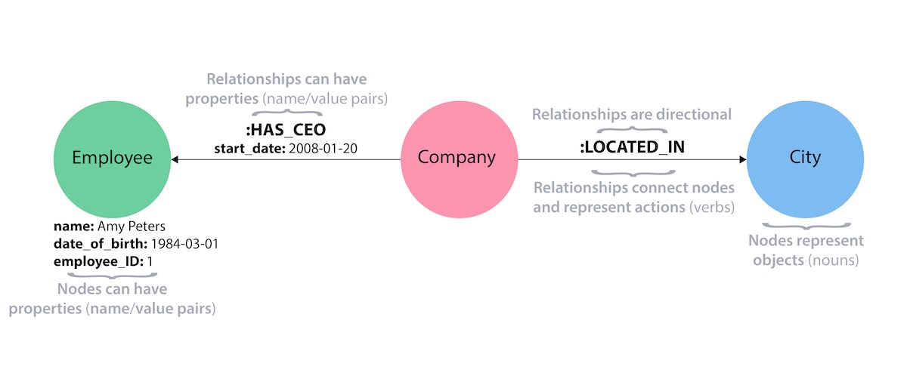
Property Graph implementations: Neo4J
Query language: Cypher
Ideas behind LPGs conceived by Swedish engineers in 2000 - 2007 while trying to build an Enterprise Content Management System (ECM)* -> Neo4J
CREATE (comp1:Company) - [:has_ceo {start_date: ‘2008/01/20’}] -> (emp1:Employee {name: ‘Amy Peters’})
Made for highly dynamic data (transactional or OnLine Transaction Processing, OLTP, paradigm)

Slide 13


Property Graph implementations: Apache TinkerPop
TinkerPop is a property graph processing framework
Query language: Gremlin

Slide 14
Property Graph implementations: Apache TinkerPop
GREMLIN
Title : …
Year: ...
Give me all movies in which “Harrison Ford” participated as a director:
Movie
# All vertices
g.V()
# All vertices that are of type Person
g.V().hasLabel(“Person”)
# All Person vertices who have name “Harrison Ford”
g.V().hasLabel(“Person”).has(“name” : “Harrison Ford”)
# Person vertices named “Harrison Ford” having outgoing “director” edge
g.V().hasLabel(“Person”).has(“name” : “Harrison Ford”).out(“directed”)
actedIn
directed
Person
Name : ...
Gender: ...

Slide 15
Gremlin graph traversal algorithms
Shortest path
g.V(start).repeat(out().simplePath()).until(hasId(end)).path().limit(1)
Paths from node
g.V(start).bothE()
Node centrality measures:
In degree: g.V().group().by().by(inE().count())
Out degree: g.V().group().by().by(outE().count())
Betweeness: g.withSack(0).V().store("x").repeat(both().simplePath()).emit().path()
Etc.
SPARQL does not natively support advanced graph traversal algorithms

Slide 16
Differences with RDF: representation & querying

Slide 17
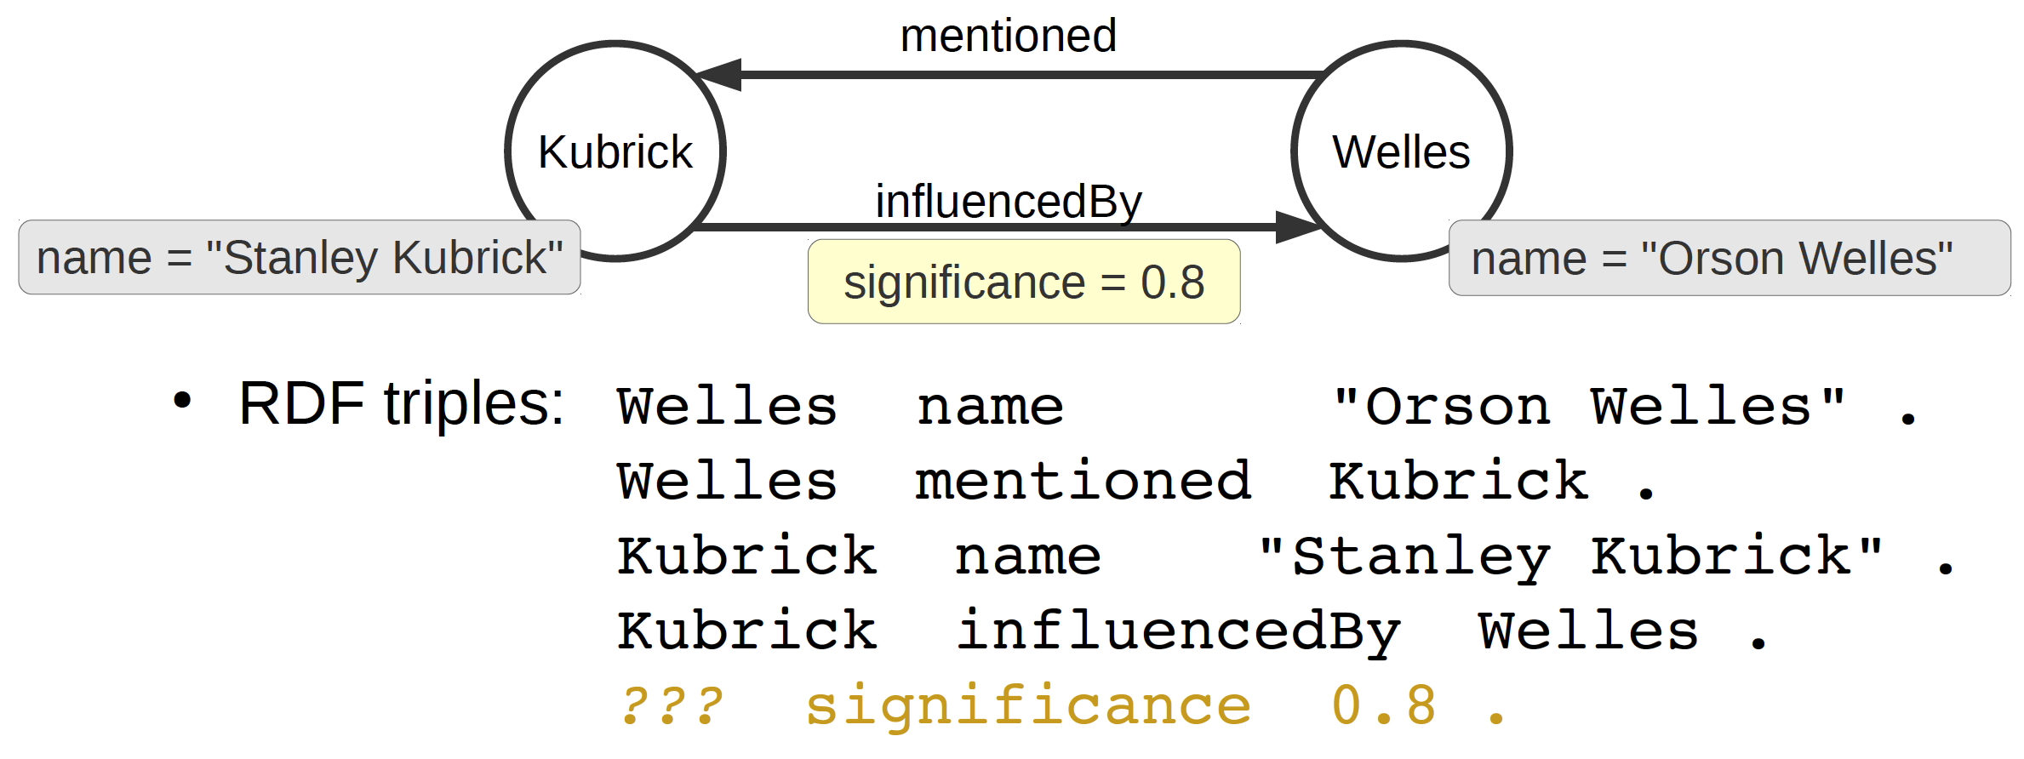
RDF workarounds
Stated in “Rolling Stone Magazine”
Can you represent the information in this picture with RDF triples?
Adapted from Olaf Hartig (WSP2018)

Slide 18
RDF workarounds
Stated in “Rolling Stone Magazine”
???
statedIn “Rolling Stone Magazine” .
Adapted from Olaf Hartig (WSP2018)

Slide 19
RDF Reification
“Rolling Stone Magazine”
rdf:Statement
statedIn
s rdf:type rdf:Statement .
s rdf:subject Kubrick .
s rdf:predicate influencedBy .
s rdf:object Welles .
s statedIn “RollingStoneMagazine” .
rdf:type
Welles
rdf:object
s
rdf:subject
Kubrick
rdf:predicate
influencedBy

Slide 20
Singleton Property
“Rolling Stone Magazine”
0.8
statedIn
Welles
Kubrick influencedBy Welles .
Kubrick p1 Welles .
p1 singletonPropertyOf influencedBy .
p1 statedIn “Rolling Stone Magazine” .
influencedBy
p1
singletonPropertyOf
Kubrick
CREATE ({name: “Kubrick”}) - [:influencedBy {statedIn: “Rolling Stone Magazine”}] -> ({name: “Welles”})

Slide 21
RDF Reification
“There is a connection between Amsterdam and Paris that costs €300 with a distance of 400 km”
“There is also another connection between these cities that costs €500 with a distance of 350 km”

Slide 22
RDF Reification
400
ams_paris_conn1 costEUR “300” .
ams_paris_conn1 to “Paris” .
ams_paris_conn1 from “Amsterdam” .
ams_paris_conn1 distanceKm “400” .
distanceKm
300
costEUR
ams_paris_conn1
to
from
Paris
Amsterdam
CREATE (ams:City) - [:connection {distanceKm: “400”, costEUR: “300”}] -> (paris:City)

Slide 23
RDF Reification
350
ams_paris_conn2 costEUR “500” .
ams_paris_conn2 to “Paris” .
ams_paris_conn2 from “Amsterdam” .
ams_paris_conn2 distanceKm “350” .
distanceKm
500
costEUR
ams_paris_conn2
to
from
Paris
Amsterdam
CREATE (ams:City) - [:connection {distanceKm: “350”, costEUR: “500”}] -> (paris:City)

Slide 24
Semantics & interoperability
Title : “Paris”
Title : “Paris”
:City
:Place
How can we automatically integrate information in these graphs?
livesIn
livesIn
Person
Person
Name : “Mary”
Name : “John”

Slide 25
Differences with RDF KGs
RDF Knowledge Graphs | LPGs
Motivated by information exchange and publishing (data generally not highly dynamic) | Motivated by efficient storage and fast querying and traversal of the graph (transactional, dynamic data)
RDF is generally applied for the Linked Data vision | Generally applied in commercial settings
Formal semantics & reasoning | No formal semantics or reasoning
RDF & SPARQL are standardised languages (W3C) | No standardized LPG language or query language
ALL information in the graph is represented with nodes and edges. I.e. RDF literals & resources are both valid nodes in an RDF graph. | Descriptive information about a node or edge can also be attached to them using key-value pairs. Literal values are not valid nodes, they have to be represented in these key-value pairs
URIs used for resources are meant to be globally unique. (according to Linked Data principles) | IDs for nodes and relations are unique to graph but not necessarily globally unique.

Slide 26
Pros & Cons of Property Graphs
Pros:
Efficient querying & storage (optimised indexing & storage of graph content)
Arguably, more intuitive data model (for capturing node & relation attributes)
Access to graph traversal algorithms (e.g. shortest path)
Can import RDF KGs into property graphs (not necessarily vice versa)
Cons:
Data integration is more difficult
No semantics & no automated reasoning
Interoperability (FAIR), no standard language

Slide 27
Summary
Property graphs are an increasingly popular way to represent information
Tuned for fast querying & traversal performance (highly dynamic big data)
Allow to specify properties (key-value pairs) of both nodes & edges
No standardized property graph query language - although GQL is under community discussion
Arguably more compact & intuitive representation than RDF
Limitations: no standardization, data integration (interoperability) & no formal semantics
Now you will learn more about a particular implementation of the property graph model - Neo4J & its query language Cypher.

Slide 28
Questions?

Slide 29
References
van Rest et al., 2016. PGQL: a property graph query language. In Proceedings of the Fourth International Workshop on Graph Data Management Experiences and Systems (p. 7). ACM.
Sun, W. et al., 2015. SQLgraph: An efficient relational-based property graph store. In Proceedings of the 2015 ACM SIGMOD International Conference on Management of Data (pp. 1887-1901). ACM.
Neo4J: https://neo4j.com/docs
Apache Tinkerpop: http://tinkerpop.apache.org
http://olafhartig.de/slides/RDFStarInvitedTalkWSP2018.pdf
http://pgql-lang.org
https://www.w3.org/TR/rdf-schema

Slide 30
References
Importing RDF into Neo4J
Towards a standardized property graph query language

